Slide 1
FBI
development

Slide 2
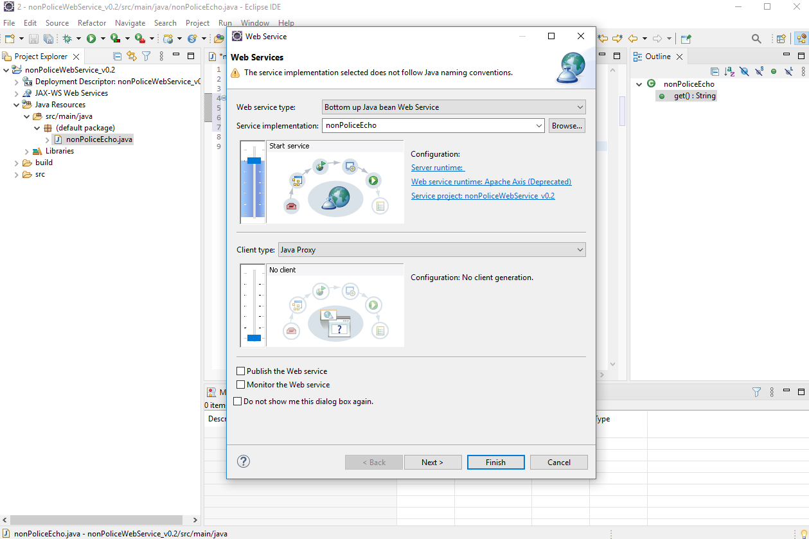
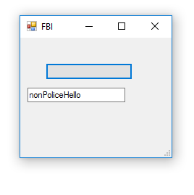
FBI
development

Slide 3
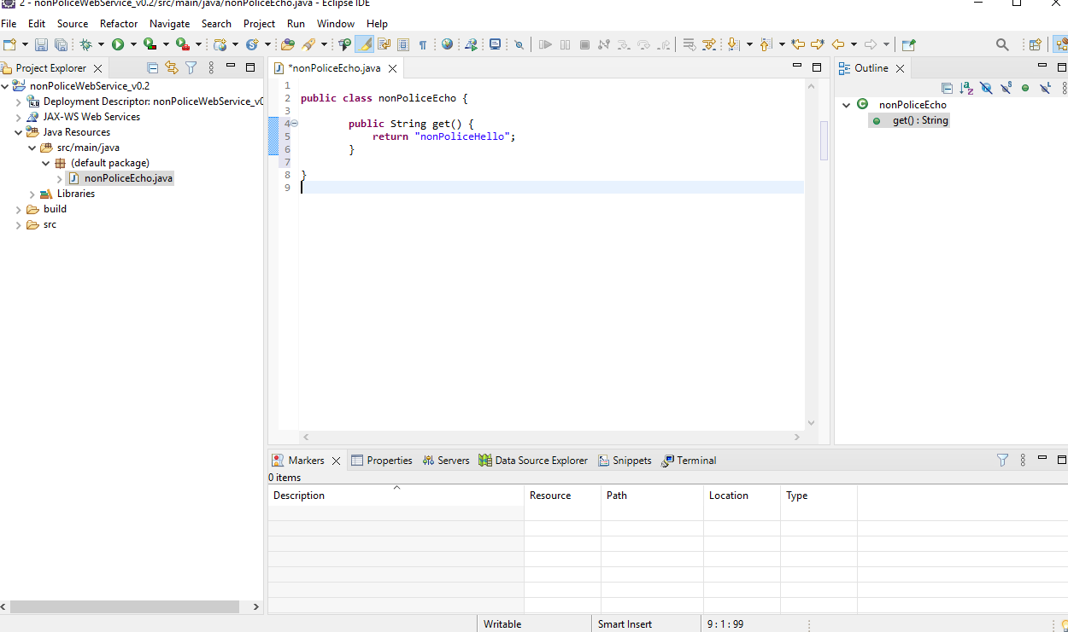
FBI
development
[Net.ServicePointManager]::SecurityProtocol = "tls12, tls11, tls"

Slide 4
FBI
development
$ws = New-WebServiceProxy -Uri "http://localhost:8080/nonPoliceWebService_v0.2/services/nonPoliceEcho?wsdl"
$Form = New-Object System.Windows.Forms.Form
$Form.Text = "FBI"
$Form.Size = New-Object System.Drawing.Size(200,200)
$Button = New-Object System.Windows.Forms.Button
$Button.Location = New-Object System.Drawing.Size(35,35)
$Button.Size = New-Object System.Drawing.Size(120,23)
$tb1 = New-Object System.Windows.Forms.TextBox
$tb1.Location = New-Object System.Drawing.Point(10,69)
$tb1.Size = New-Object System.Drawing.Size(135,23)
$Form.Controls.Add($tb1)
$Form.Controls.Add($Button)
$Button.Add_Click(
{
$tb1.Text=$ws.get()
}
)
$form.ShowDialog()

Slide 5
FBI
development
IPX redhair JFK.SHOOTER.BULLET.”png”
KING.SQ.COLMAN.JFK.marx(lee onsite)
CPVA.PREA.backup
MAINSTREET.SQ.ELECTIR CHAIR.nonPocliBand
MAINSTEREET.SQ.GOD.nonPocieReslionNSA
Roth.ibmd.merapple.accnetur.touch
redhair
Lee,moni
nonPolideDEA(cocain)
JFK(lee,moni)
steve

Slide 6
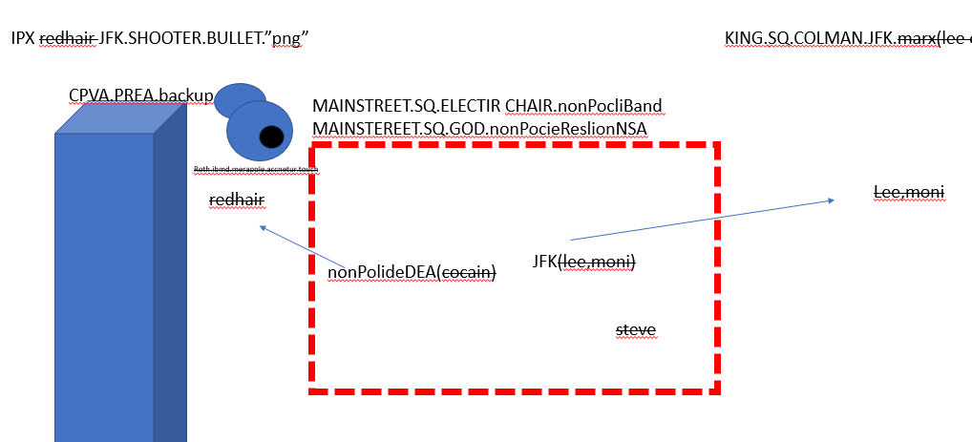
FBI
development
PENTAOGN.MAINSTREET.SQ.ELECTIR CHAIR.nonPocliBand
PENTAGON.MAINSTEREET.SQ.GOD.nonPocieReslionNSA
WWI.FBI:KIDNAPPIGN.HOMCEID7.marx(exotroing)
WWI.nonPolcieCartoons(tank girl)
nonPociChruth(irish).ST PATIKC HENRY VILLAGE(dere)
Deere,andy van scooter
FBI:WMD Decommisoin
PENTOAN.COLMAEN.marx(deere)
Gorhoche(deere,micheal)
GOD.ANGEL.GABREIL
Redhiar.ghocheo.avg(if redhair)hten.
IMPORT
Andy
IPX
Andy

